Slide 1
DHCP SERVER configration
System & network administration

Slide 2
dhcp
Dhcp stands for dynamic host configuration protocol
where
Dynamic automatic
Host client/computer
Configuration to provide ip (public + private) for communication(mostly private ip)
Protocol set of rules

Slide 3
Dhcp functions at application layer of tcp/ip protocol stack. one of the primary task of this protocol is to automatically assign ip addresses to dhcp, ip addresses that are assigned via dhcp server are regarded as dynamically assigned ip addresses
In networks dhcp provide private ip and in out of networks(on internet) private ip is converted to public ip using NAT.

Slide 4
Lets have look how dhcp works
We know that every computer wants ip to communicate.
Lets suppose we have one switch and nine computers are connected with switch and switch is knowing ip addresses of all computers connected with it.Now here a new pc wants to connect with this network this pc has no ip address here DHCP server gives IP address to that pc to connect with this network.
For small number of pc’s ip address can be manually assigned where as for large number of computers it is difficult even impossible to assign ip addresses manually so for this case DHCP server is used which automatically assigned Ip addresses to large number of computers.
You can configure router or computer as DHCP server.

Slide 5
dhcp
It automatically assign IP address to DHCP client.
It is based on client-server model(client request for IP)
DHCP works on application layer
IP addresses assigned is known as dynamic Ip addresses.
Note: Dynamic IP address means least time is fixed for allocation of IP addresses, if client don’t send request for renewal of IP address DHCP takes back that IP and allocate it to other client.
DHCP’s IP addresses range is called scope. It means once the classes are defined in DHCP server it will allocate addresses to all other clients according to the class assigned to DHCP. In wifi devices scope is fixed by companies.
Boot P is another method to allocate IP, but mac addresses must be entered manually in Boot P.

Slide 6
DHCP is a dynamic Boot P.
DHCP server can provide
IP Addresses
Subnet mask
Domain Name
Default Gateway
DNS server address
Windows Naming Server

Slide 7
On Transport layer it uses UDP (employs connectionless service model)
Destination Port used by DHCP server is 67
Port used by DHCP Client is 68

Slide 8
DORA PROCESS
When a computer or other device connects to a network, the DHCP client software sends a broadcast query requesting the necessary information. DHCP process goes through 4 stages while assigning an ip address to the client. these stages are often abbreviated as DORA
D for discovery,
O for offer,
R for request,
A for acknowledgement.

Slide 9
Dora process
DHCP MESSAGE | Description
DHCP Discover | UDP broadcast from DHCP client to locate available server Layer 2 broadcast FF:FF:FF:FF:FF:FF Layer 3 broadcast 255.255.255.255
DHCP Offer | DHCP server to client in response for DHCP discover with offer of configuration parameters(IP address of DHCP server offer IP, Mac address of client ,subnet mask, lease length)
DHCP Request | Client then broadcast to server, a DHCP request message assigned for offer, IP address and possible other info
DHCP Acknowledge | Server to client with configuration parameter including committed network address

Slide 10
Commands for DHCP configration
First create two machines one is server and other is client.
On server machine IP must be configured statically, Following process is used for statically configuration of IP address
First go to machine’s wired setting/network setting
Then click on button here add profile and write manually IP address and net mask then click on DONE. You can use ifconfig command on terminal to check this address.
Now run these commands on server machine
#yum install dhcp or yum install dhcp-server
#cd/etc/dhcp/
# ls

Slide 11
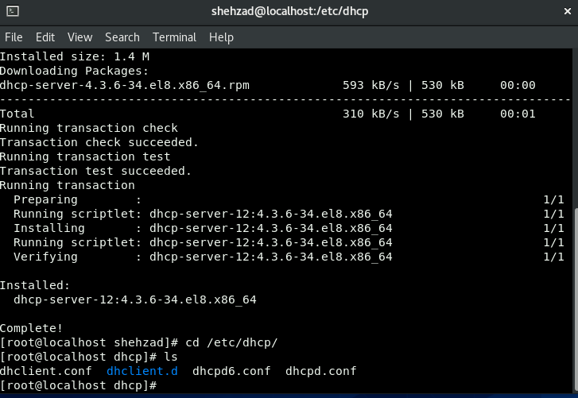

Slide 12
Once installation is complete, configure the interface on which you want the DHCP daemon to server request. Go in the configuration file on DHCP server machine :
vi /etc/sysconfig/dhcp
For example , if you want DHCP to listen on ‘eth0’ set it using the following directive :
DHCPDARGS = “eth0”
Now set the Global Parameters and Declarations by going to the main DHCP configuration file tat is located at /etc/dhcp/dhcpd.conf
❖ cp /usr/share/doc/dhcp-server/dhcpd.conf.example /etc/dhcp/dhcpd.conf
Now, Open and edit the configuration file to configure your DHCP server :
❖ vi /etc/dhcp/dhcpd.conf

Slide 13
Defining the Global Parameters :
default-lease-time 600;
max-lease-time 7200;
authoritative;
log-facility local 7;

Slide 14
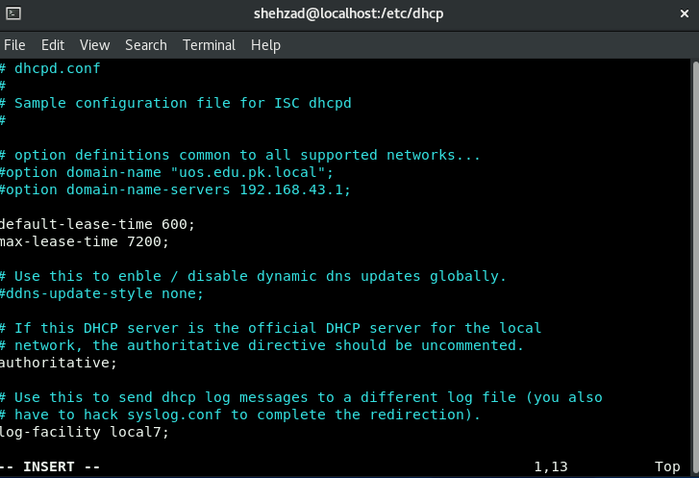

Slide 15
Next,you need to define a sub-network Declaration :
subnet 192.168.43.0 netmask 255.255.255.0
{
range 192.168.43.190 192.168.43.200 ;
option routers 192.168.43.1 ;
option broadcast-address 192.168.43.255;
option subnet-mask 255.255.255.0 ;
option domain-name-servers 8.8.8.8;
}

Slide 16
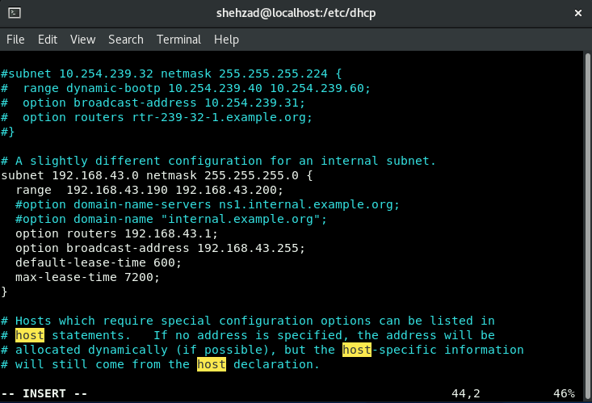

Slide 17
If you want to assign a specific IP Address to a specific client
❖
Then first check the Mac Address of the desired system
If the client machine is Windows then use the command :
ipconfig /all
Then first go to the dhcpd.conf file
# vim /etc/dhcp/dhcpd.conf
Then do some changes
host abc {
hardware Ethernet 00:71:CC:6C:8E:33;
fixed-address 192.168.43.193;
} :wq!

Slide 18
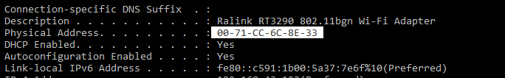
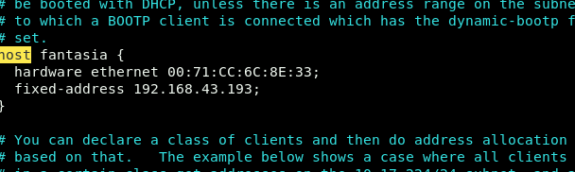
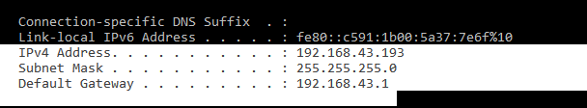

Slide 19
Starting Service
# systemctl start dhcpd (start service for the mean time)
# systemctl enable dhcpd (automatically start from next system boot)
# systemctl status dhcpd (check it is up and runnung)

Slide 20
Firewall configuration
# firewall - cmd - - permanent - add - - service=dhcp
# firewall - cmd - - reload

Slide 21
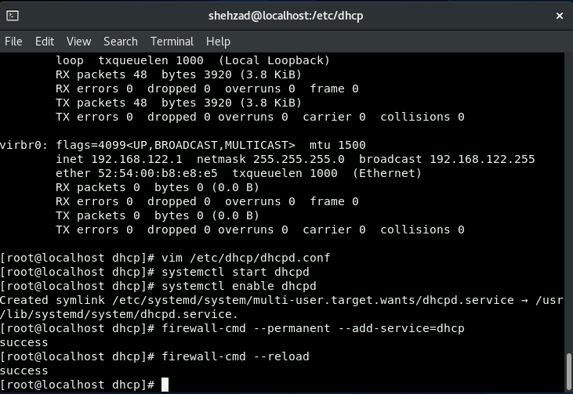

Slide 22
DHCP Client configuration ( LiNux )
On client device modify the following file :
vi etc/sysconfig/network
By setting : NETWORKING = yes
Now edit ethernet configuration file :
vi /etc/sysconfig/network-scritps/ifcfg-eth0
Set parameters to the following values :
DEVICE = eth0
BOOTPROTO = dhcp
TYPE = Ethernet
ONBOOT = yes

Slide 23
DHCP Client configuration ( windows )
First click on control panel
Then click on network & sharing center
Then click on connections
Then click on properties
Then click on internet protocol version 4
Then click on obtain an IP address automatically
Then simply click on OK

Slide 24
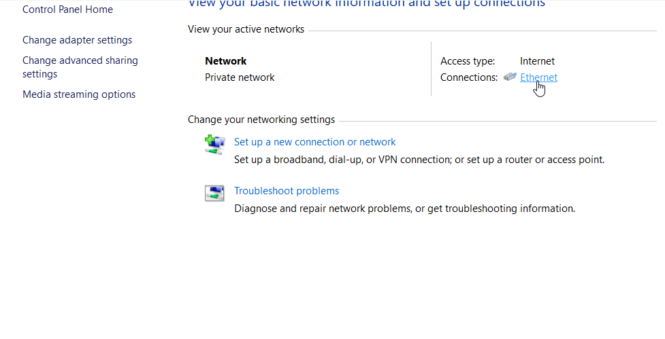
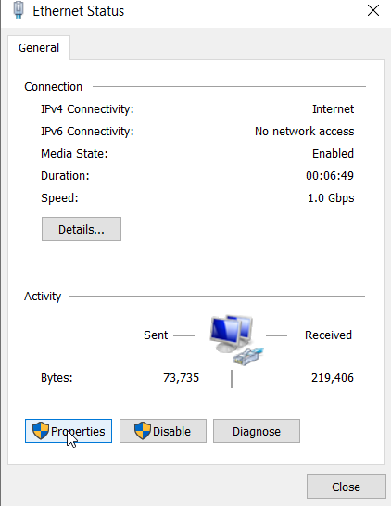

Slide 25
